Slide 1
Box Office Blueprint: Data-Driven Insights for Microsoft Movie Studio Launch.
Objective:
This project aims to guide the establishment of a new movie studio by providing actionable insights into the key factors driving box office success.
We explore data from IMDB, The Movie Database (TMDb), and the numbers to understand what types of movies perform well at the box office.
The goal is to extract patterns in genres, ratings, and other characteristics to guide the studio’s production strategy.

Slide 2
Problem statement.
The new movie studio lacks experience in filmmaking and needs insights to:
Identify successful movie characteristics.
Pinpoint profitable genres.
Determine optimal budget ranges.
Strategize release timings to maximize box office revenue.

Slide 3
Data Understanding.
The dataset used for this project combines information from multiple sources, each offering unique and complementary insights into movie attributes and box office performance. Below is a breakdown of the data sources used and the specific datasets obtained from each.
Data source
Below are the sources of the data : -1. IMDB -2. Rotten Tomatoes -3. TheMovieDB -4. The Numbers -5. Box Office Mojo
Datasets Used in Analysis
After performing an initial assessment, cleaning, and merging of data, we used the following datasets for analysis:
tn.movie_budgets.csv.gz → Used for financial and studio performance analysis (budget, gross, profit, ROI).
bom.movie_gross.csv.gz → Supplementary financial data, focusing on domestic and international gross.
imdb.title.basics.csv.gz → Used to extract genre, runtime, and title information.
imdb.title.akas.csv.gz & imdb.title.principals.csv.gz → Used to identify directors, actors, and producers for cast analysis.

Slide 4
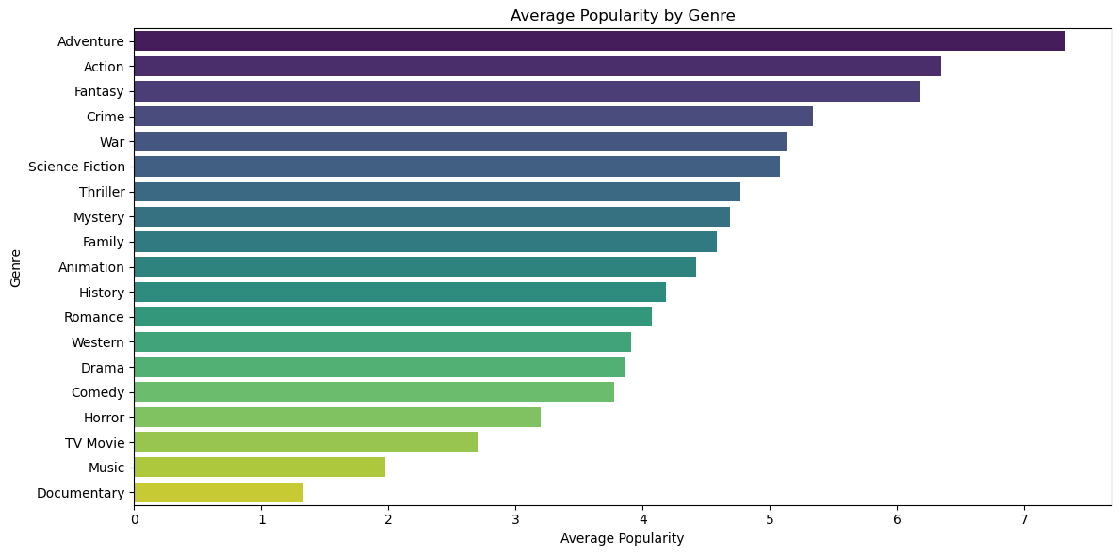
Results and findings: Genre Performance

Slide 5
Genre performance contd….
Top Performing Genres (based on average statistics):
Action: High popularity, moderate ratings (large audience but some mixed reception).
Fantasy: Very high popularity and generally good ratings (attracts both mainstream and dedicated audiences).
Drama: Strong ratings but lower popularity compared to Action/Fantasy.
Animation: Very high ratings with moderate popularity — beloved by families and audiences seeking quality storytelling.
By focusing on these top-performing genres, studios can optimize their content portfolio to maximize both audience engagement (popularity) and viewer satisfaction (ratings), ensuring both financial returns and critical acclaim.

Slide 6
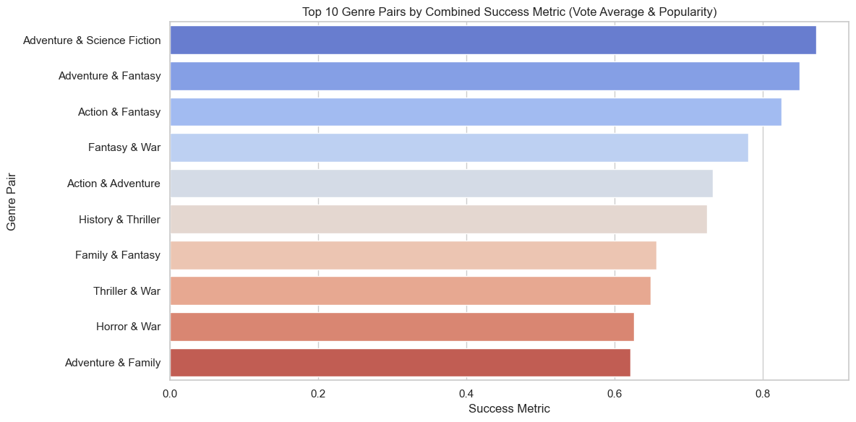
Results and findings: Genre pairs by combination success metrics (Vote average& popularity)

Slide 7
Top Performer: Adventure & Science Fiction is the top combo with a success metric of 8.7
2. Adventure & Fantasy (8.5), Strong contender with excellent audience approval and reach.This genre pair works well for epic journeys, mythical stories, or fantasy worlds — think Harry Potter or Lord of the Rings.
Genres to Watch Carefully:Some genre pairs like Action & Thriller have decent popularity but relatively lower vote_average.

Slide 8
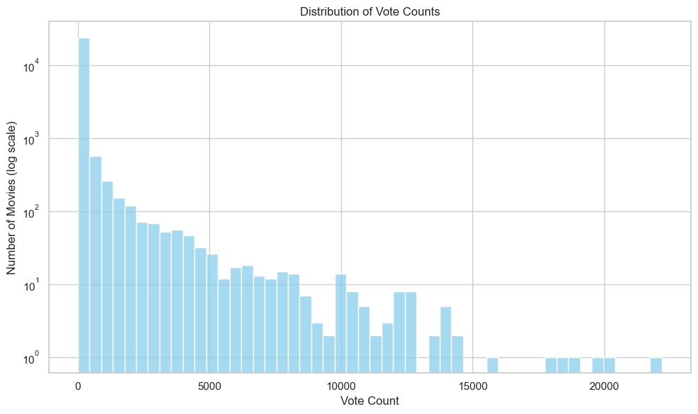
Results and findings: Audience Engagement

Slide 9
Audience engagement contd….
Majority of movies seem to have low-to-moderate engagement (around 100 to 1,000 votes). This could be due to independent or niche films that don't reach mass audiences.
The long tail of high vote counts is an indicator of a few blockbusters or popular movies that generate significant attention (e.g., Avengers, Harry Potter, etc.).
Actionable Insights:Studios aiming for broader audience engagement might want to focus on genres that have a higher likelihood of generating high vote counts.
Typically, action, adventure, and sci-fi genres see more engagement.
Targeting niche genres with consistent moderate engagement may be a way to ensure sustained, smaller but loyal audiences.

Slide 10
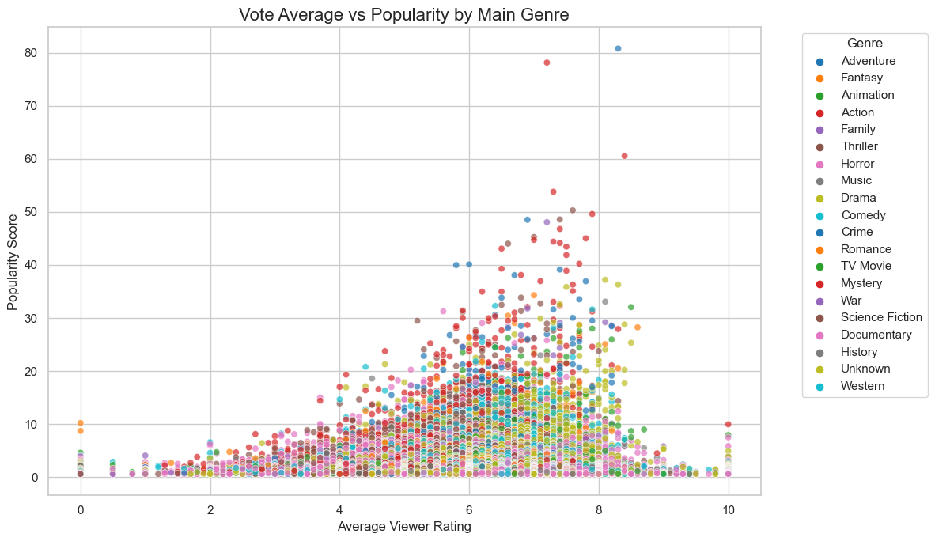
Result and findings: Vote average vs popularity by main genre.

Slide 11
Popularity vs Ratings: From the chart we can see viewer ratings of 6 and above indicate high popularity in the movies.
Popular action movies may bring in a large audience for their flashy effects and colorful explosions, but those films end up having mixed or average reviews.
Drama, Animation and Family genres have gentler extremes, whereas Action, Sci-Fi, and Adventure tend to be more polarized with their reception. Because of differing audience expectations, some are likely to love them, and some will definitely hate them.
When planning films, especially for large scale blockbusters versus small scale niche films, studios must consider the possible popularity level and how the audience will receive it.

Slide 12
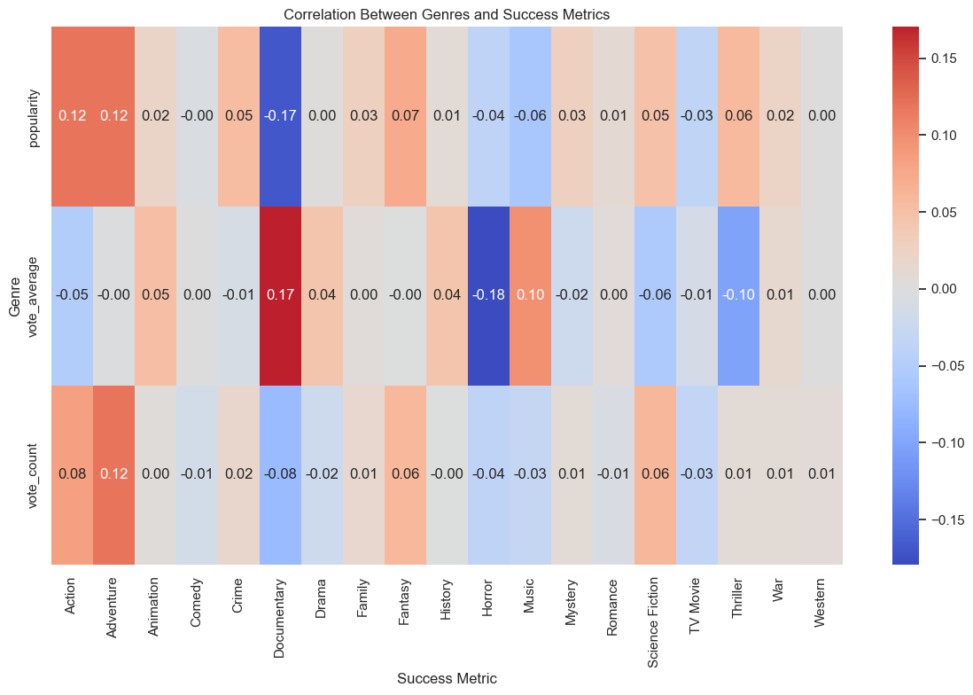
Checking the correlation using popularity,vote_average and vote count.

Slide 13
Brighter red cells: Indicate strong positive correlation
Brighter blue cells: indicate strong negative correlation
How to InterpretGenres with high values in “popularity” column: More likely to attract large audiences.
Genres with high “vote_average”: Likely critically acclaimed.
Genres with high “vote_count”: Receive more viewer engagement or mainstream appeal.
Insight:-
If your studio wants high **popularity and engagement**, focus on **Action**, **Adventure**, or **Sci-Fi**.- If aiming for **high ratings**, **Documentary** and **History** genres show stronger positive correlations.

Slide 14
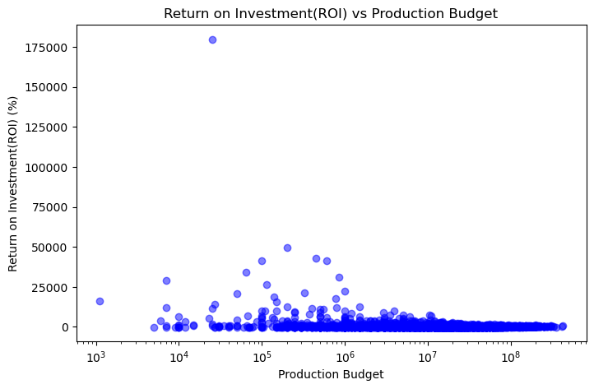
Results and findings: Return on investment vs Production Budget.

Slide 15
Aim:
For every \$1 that was spent, how much (%) did they get back in profit?
Observations:
High ROI isn't tied to high budget - The movies with the highest ROI are mostly in the low to mid-budget range (\$10k–\$1M).
Big budgets ≠ big ROI - Expensive movies (>\$100M or 10^(8)) tend to have lower ROI, even if they make lots of money because their production costs are huge.
Diminishing returns at higher budgets - As budgets grow, ROI tends to flatten. Studios make profits, but the percentage return shrinks.
Recommendations.
Consider low to Mid budget movies as they can be highly profitable - These movies are less risky and often perform better per dollar invested.
For example \$1M movie can return 5000% ROI. Avoid avoid mega budgeted movies early on because they don’t guarantee high ROI and they are huge risks because they need global distribution power.

Slide 16
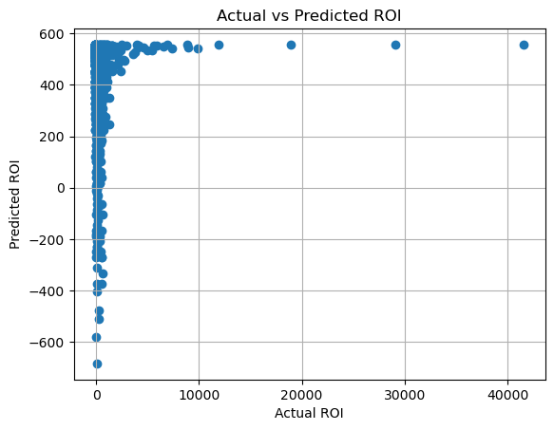
Results and findings: Regression Results.
To explore this, we used ROI as the target variable and production budget as the predictor. We applied a simple linear regression model to examine the relationship and evaluated its performance using R² and Mean Square Error (MSE)

Slide 17
Regression contd…
The model shows that production budget alone has almost no predictive power for a movie’s ROI (R² = 0.0069), meaning we can’t reliably estimate profitability just from how much was spent on production.
This weak relationship highlights a key limitation: production budgets typically exclude other critical financial factors such as marketing expenses, cinema or streaming platform cuts, and backend deals.
Simply spending more on production doesn’t guarantee higher returns. To make better predictions, we would likely need a broader range of data that captures the full financial picture of a movie’s lifecycle.

Slide 18
Recommendations.
Focus on producing Action, Adventure, and Fantasy films.
Prioritize stories that resonate globally and generate online engagement.
Consider genres that maintain consistent viewer ratings.
Boost vote count through marketing campaigns, early fan screenings, and sequels.
Leverage genre-specific tones and storytelling to match audience preferences

Slide 19
Next Steps
Conduct deeper modeling to predict box office revenue.
Integrate marketing and budget data for richer insights.
Test concepts with focus groups aligned with top genres.
Conduct deeper analysis into budget vs return per genre
Analyze international markets to align global preferences
Incorporate text sentiment from reviews to refine tone/style recommendations

Slide 20
Q&A / Conclusion
Conclusion: Data supports a clear strategic focus on Adventure, Action, and Fantasy. These genres offer consistent popularity, high audience engagement, and room for creative expansion.
Authors
Hafsa Mohammed
Ryan Karimi
Rose Muthini
Elizabeth Ogutu
Thank you

